Slide 1
Medicine Side-effect Analysis
Team 5

Slide 2
Business Objective
To predict a drug with zero/least side-effect for the patient based on the reviews and rating .
Current evidences show the advantages of medicine reviews by users for the safe and effective use of medicines. This data set provides the opinions of consumers about their conditions and the medicines that they have used.
This product could be helpful for companies like 1mg to provide detailed rating of the side effects of the product over their site. It could also be helpful for the patients who are buying drugs online to check the side effects of the drugs before buying it.

Slide 3
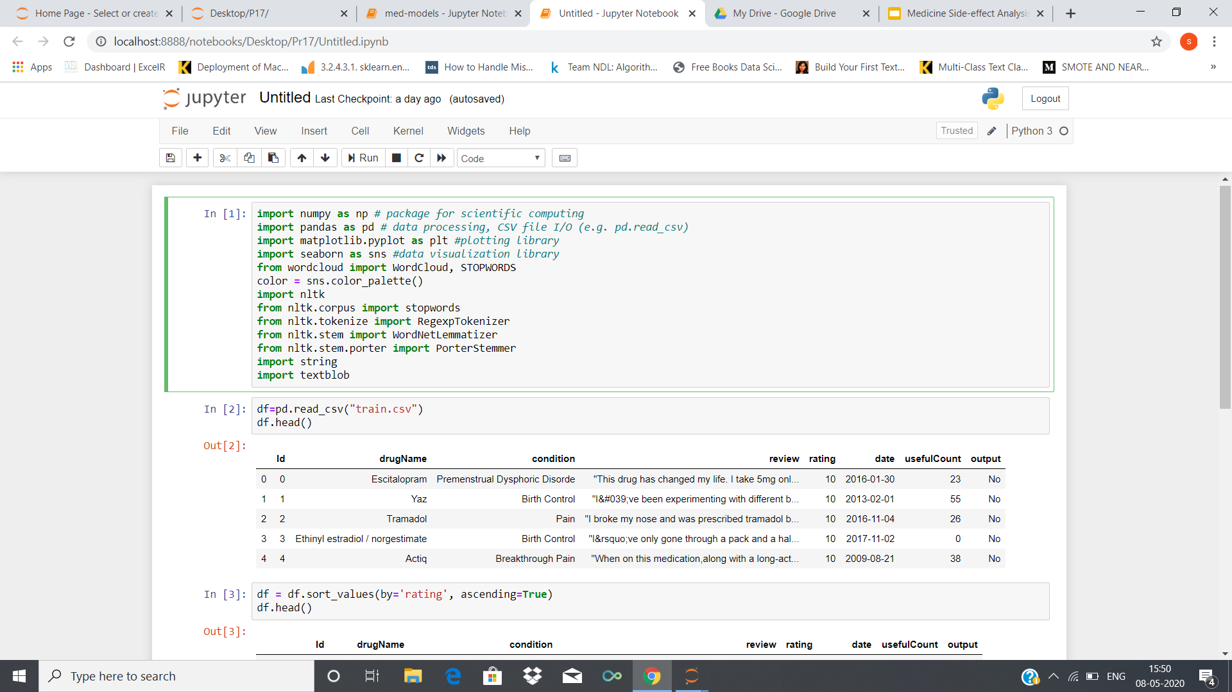
Dataset Details
Train data set has 8 columns and 40324 rows.
Test data set had 7 columns and 13442 rows.
Contains 219 missing values.
Consists of categorical/alphanumeric values.
There are no duplicate values.

Slide 4
1) These are the explanations for variables.
drugName (object): name of drug.
condition (object): name of condition.
review (object): patient review.
rating (numerical): 10 star rating by patient.
date (object): date of review entry.
usefulCount (numerical): number of users who found review useful.
Output(object):Whether the drug has side-effects or not i,e.,Yes or no
2) The train set is almost exactly 3 times as big as the test set. This is a typical 75:25 train:test split.
3) There are 2419 drugs and 674 conditions listed in the data set respectively.

Slide 5
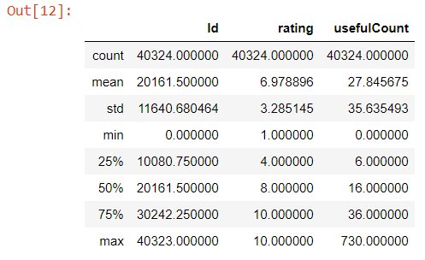
EDA
Summary of the data set
train.describe()

Slide 6
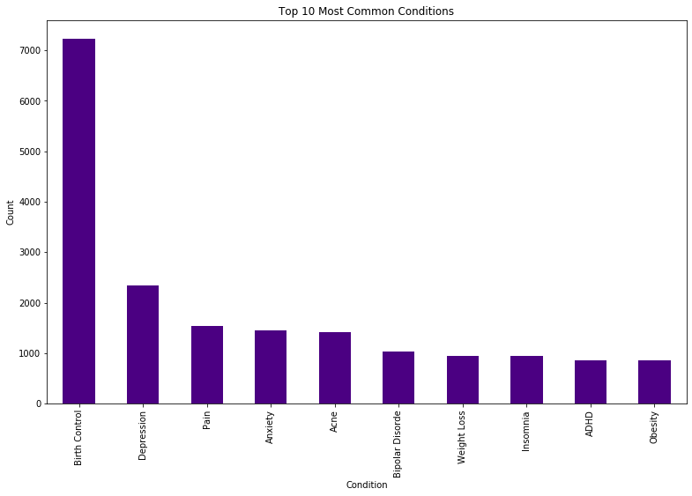
The following Histogram shows the top 10 conditions that people are suffering from.
Birth Control 7233
Depression 2346
Pain 1538
Anxiety 1457
Acne 1417
Bipolar Disorder 1030
Weight Loss 940
Insomnia 936
ADHD 859
Obesity 855

Slide 7
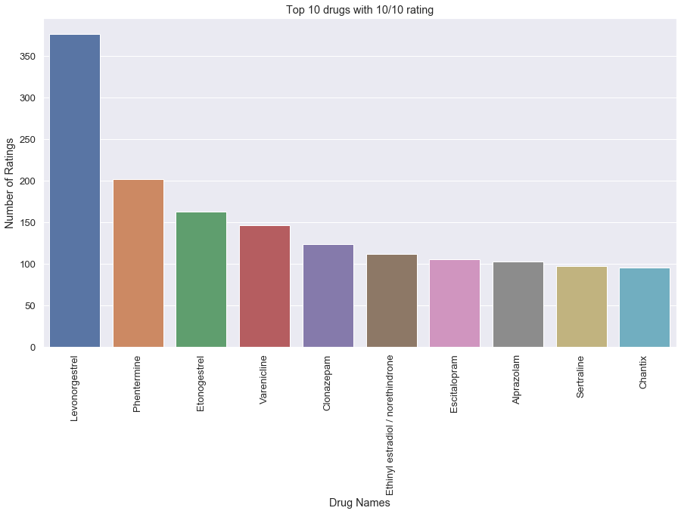
Top 10 drugs with highest ratings

Slide 8
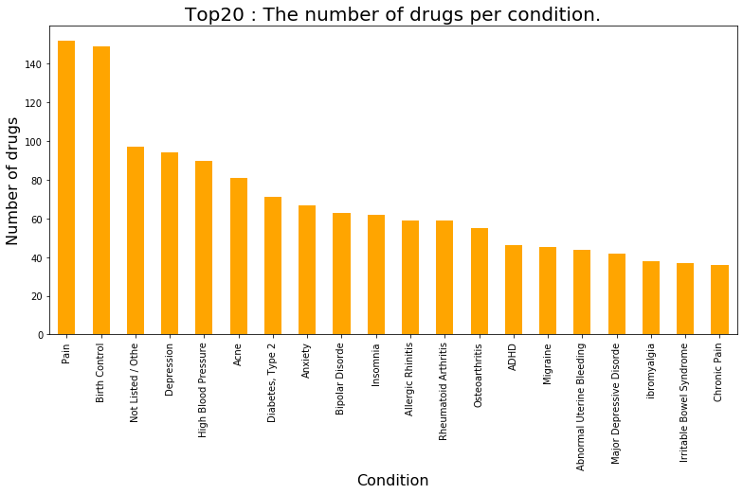
Several drugs can be used for a single condition. Therefore, by grouping the drug name and condition , we obtain a bar plot of number of drugs per condition.
Condition
Pain 152
Birth Control 149
Not Listed / Othe 97
Depression 94
High Blood Pressure 90
Acne 81
Diabetes, Type 2 71
Anxiety 67
Bipolar Disorder 63
Insomnia 62
Allergic Rhinitis 59
Rheumatoid Arthritis 59
Osteoarthritis 55
ADHD 46
Migraine 45
Abnormal Uterine Bleeding 44
Major Depressive Disorder 42
ibromyalgia 38
Irritable Bowel Syndrome 37
Chronic Pain 36

Slide 9
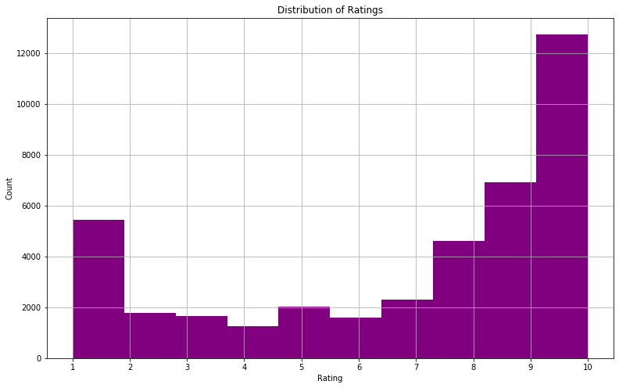
Distribution of ratings

Slide 10
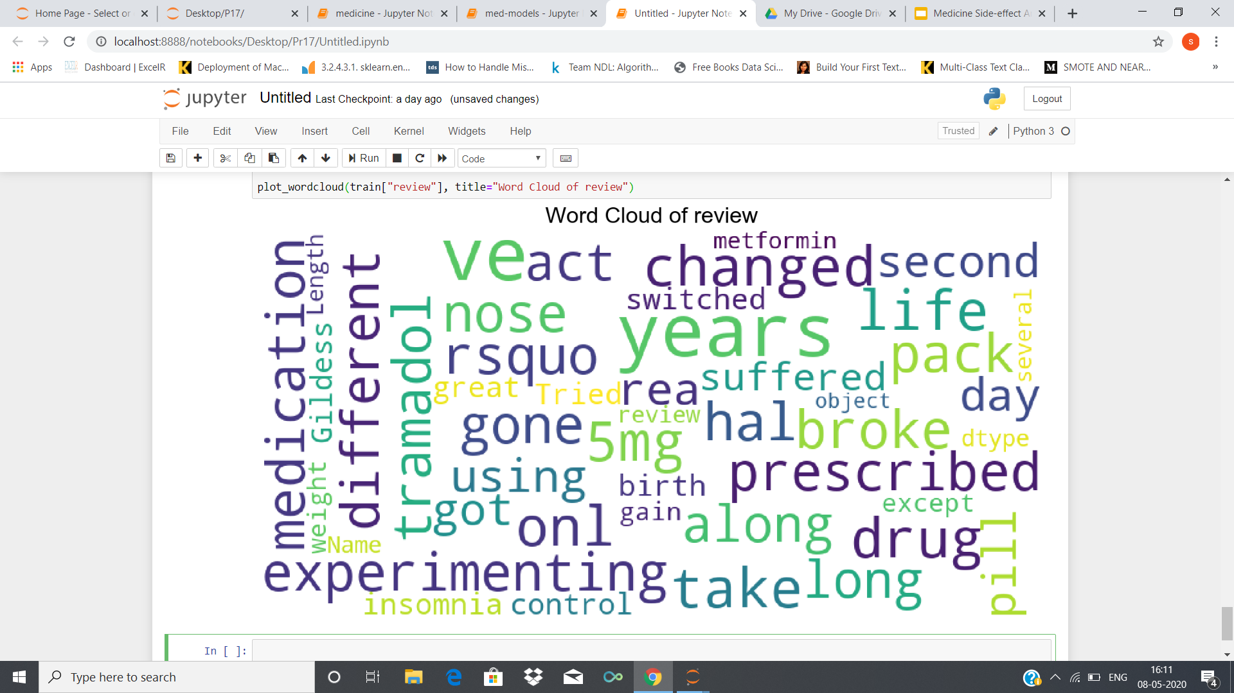
Word Cloud

Slide 11
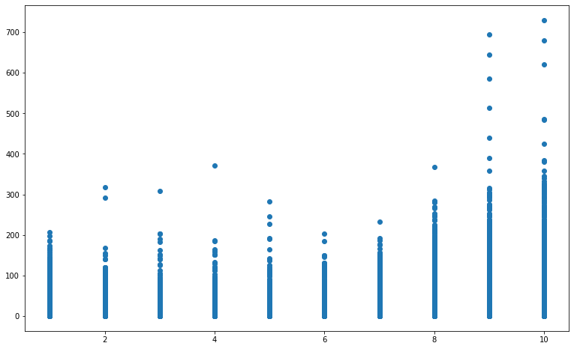
Correlation between the the features ‘usefulCount’ and ‘rating’

Slide 12
Correlation values:
Id rating usefulCount
Id 1.000000 -0.001954 0.006629
rating -0.001954 1.000000 0.237480
usefulCount 0.006629 0.237480 1.000000
​

Slide 13
Sentiment Analysis
VADER (Valence Aware Dictionary and sEntiment Reasoner) is a lexicon and rule-based sentiment analysis tool that is specifically attuned to sentiments expressed .
VADER belongs to a type of sentiment analysis that is based on lexicons of sentiment-related words. In this approach, each of the words in the lexicon is rated as to whether it is positive or negative, and in many cases, how positive or negative.
from nltk.sentiment.vader import SentimentIntensityAnalyzer

Slide 14
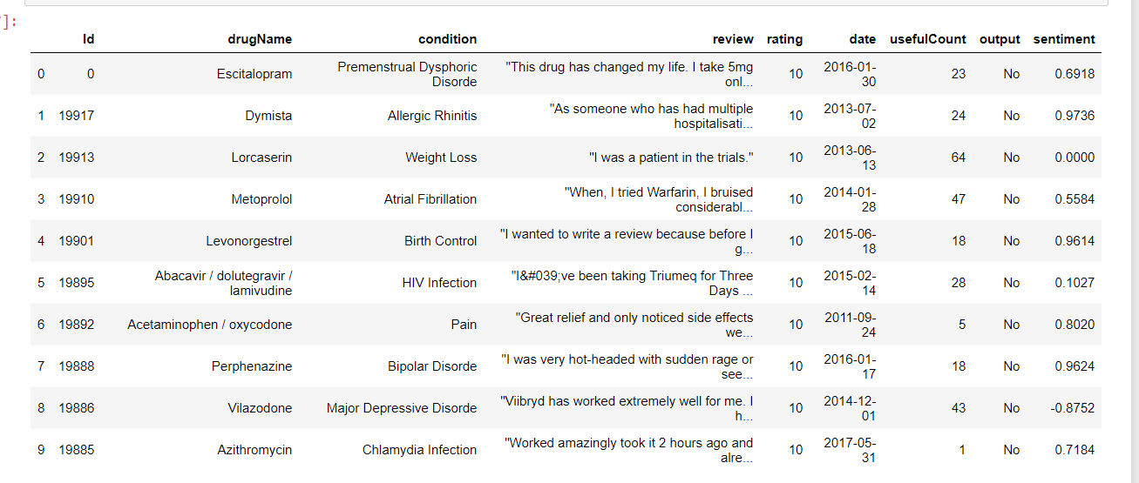

Slide 15
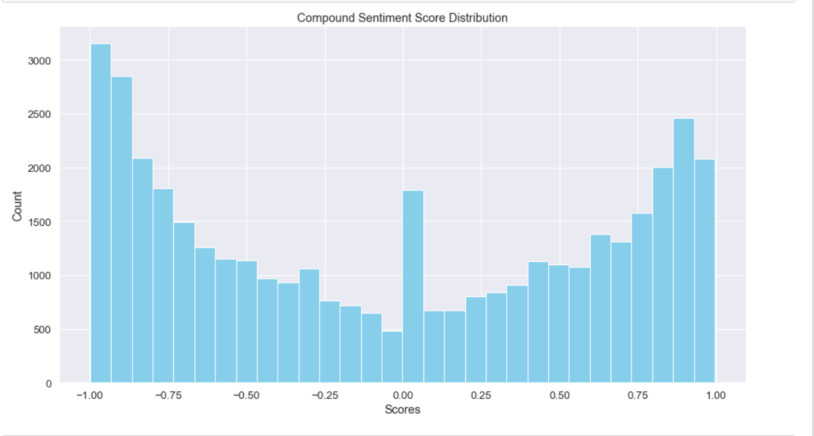
Compound score distribution

Slide 16
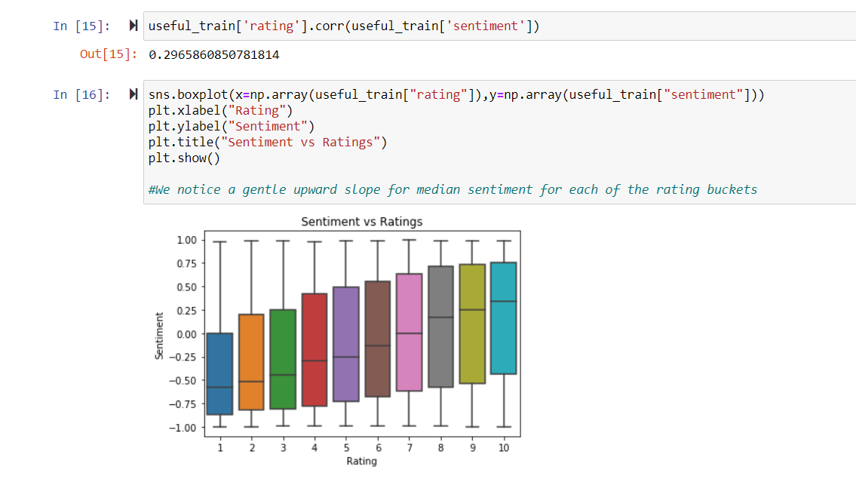
Correlation between ‘rating’ and ‘sentiment’

Slide 17
NAIVE BAYES
In machine learning, naïve Bayes classifiers are a family of simple probabilistic classifiers based on applying Bayes' theorem with strong (naïve) independence assumptions between the features.
Naïve Bayes classifiers are highly scalable, requiring a number of parameters linear in the number of variables (features/predictors) in a learning problem.
Maximum-likelihood training can be done by evaluating a closed-form expression, which takes linear time, rather than by expensive iterative approximation as used for many other types of classifiers.

Slide 18
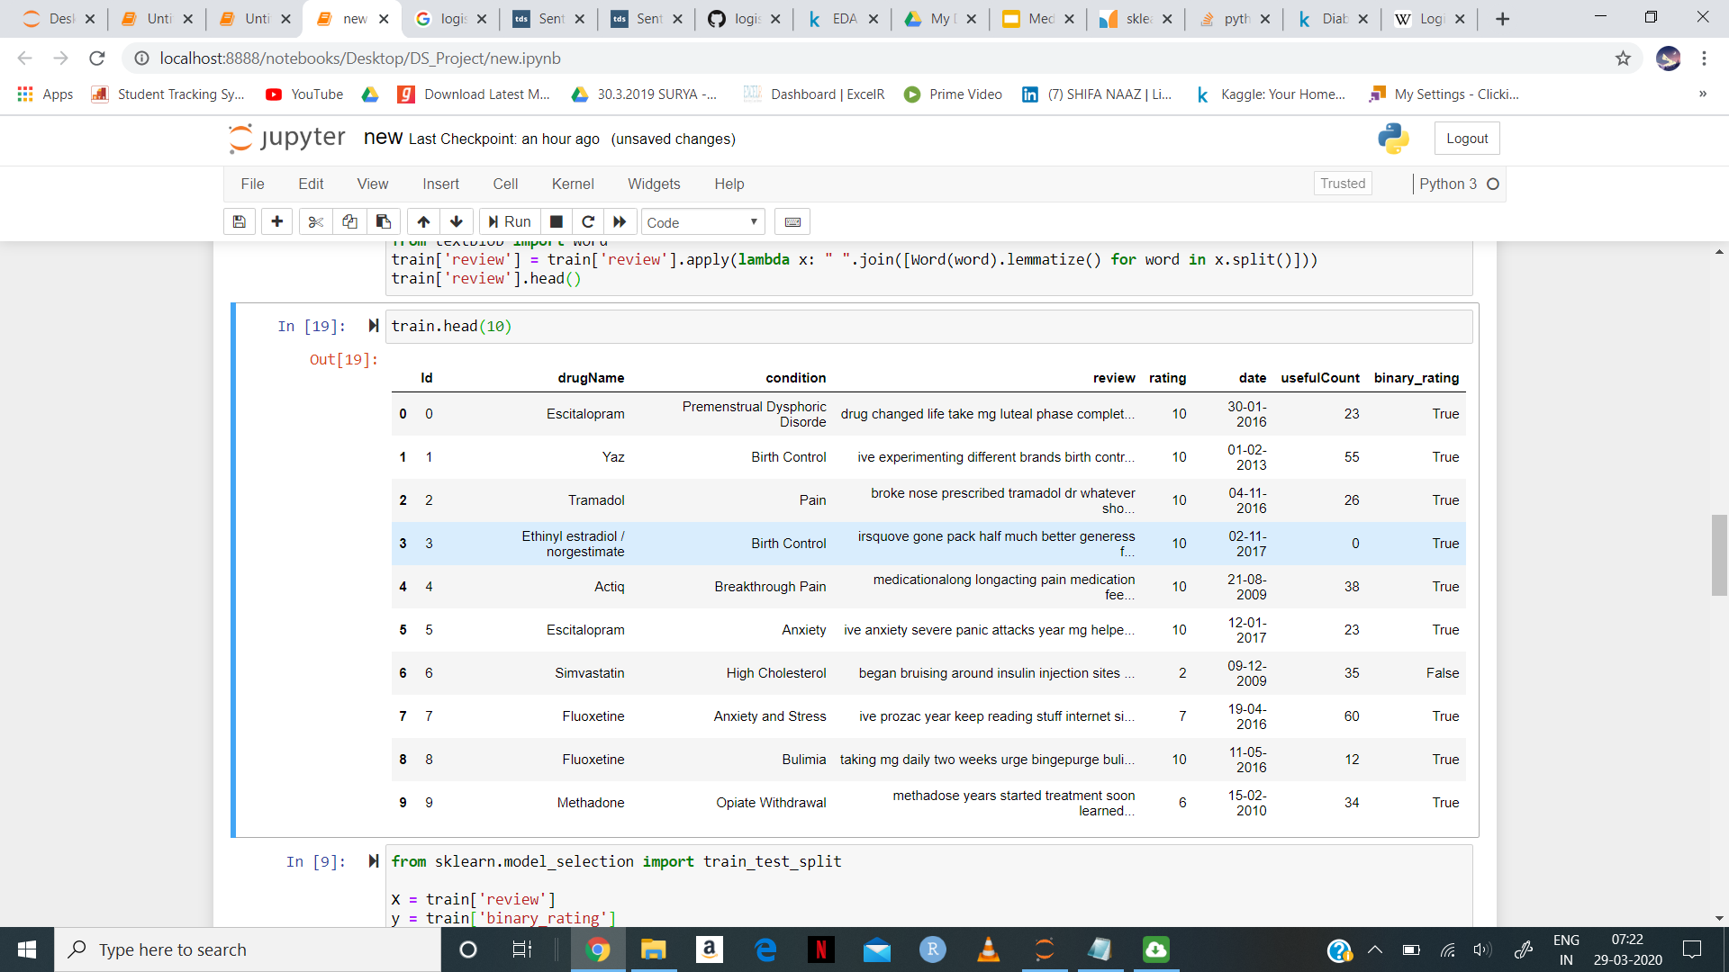
The simplest type of model we can attempt to fit on this data is the Naive Bayes classifier. We will first test Naive Bayes on a binarized version of the rating column which attempts to identify which reviews are favorable. We define a favorable review as one which received a rating above 5. Given the sample size involved for our data set, we choose Naive Bayes over other classifiers due to its scalability.

Slide 19
CountVectorizer
The CountVectorizer provides a simple way to both tokenize a collection of text documents and build a vocabulary of known words, but also to encode new documents using that vocabulary.Call the transform() function on one or more documents as needed to encode each as a vector.
For our specific problem, this gives us a larger number of tokens towards the sentiment of a review. This will produce more semantically meaningful tokens and lead to better scalability and predictive power for our machine learning models.

Slide 20
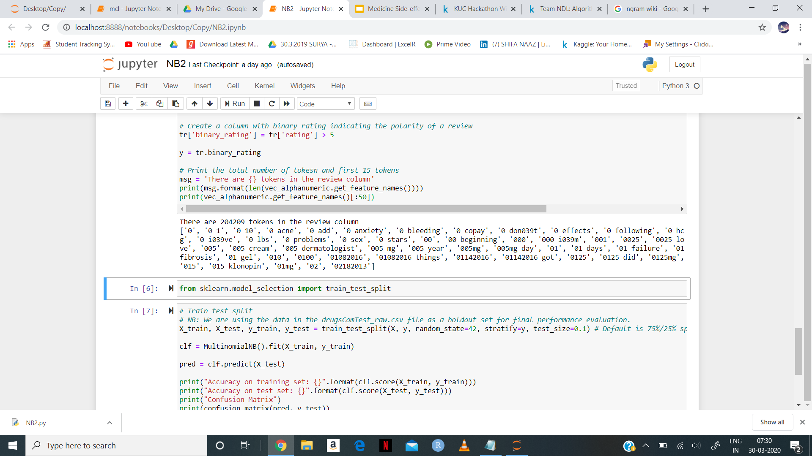
The above output indicates that the size of our vectorized reviews will be rather large which indicates that we'll need to do some tricks to make our learning algorithms (beyond Naive Bayes) perform well at this scale. Moreover, from the tokens above, it seems that we will need some form of preprocessing. If we think back to the data exploration performed earlier in the notebook, we can see that when the reviews were scraped from the web, there were certain formatting patterns which we could replace to get more meaningful tokens.

Slide 21
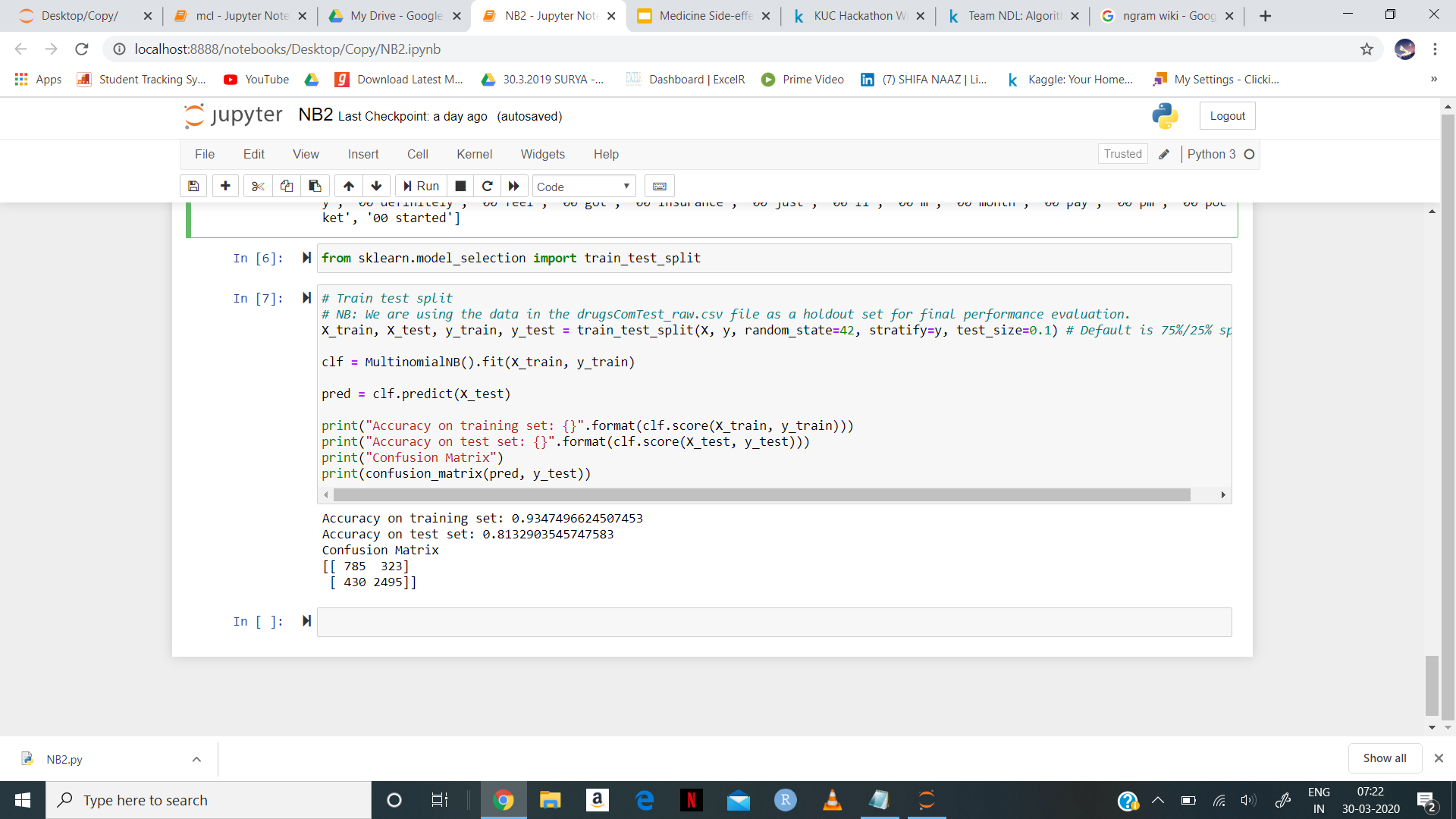

Slide 22
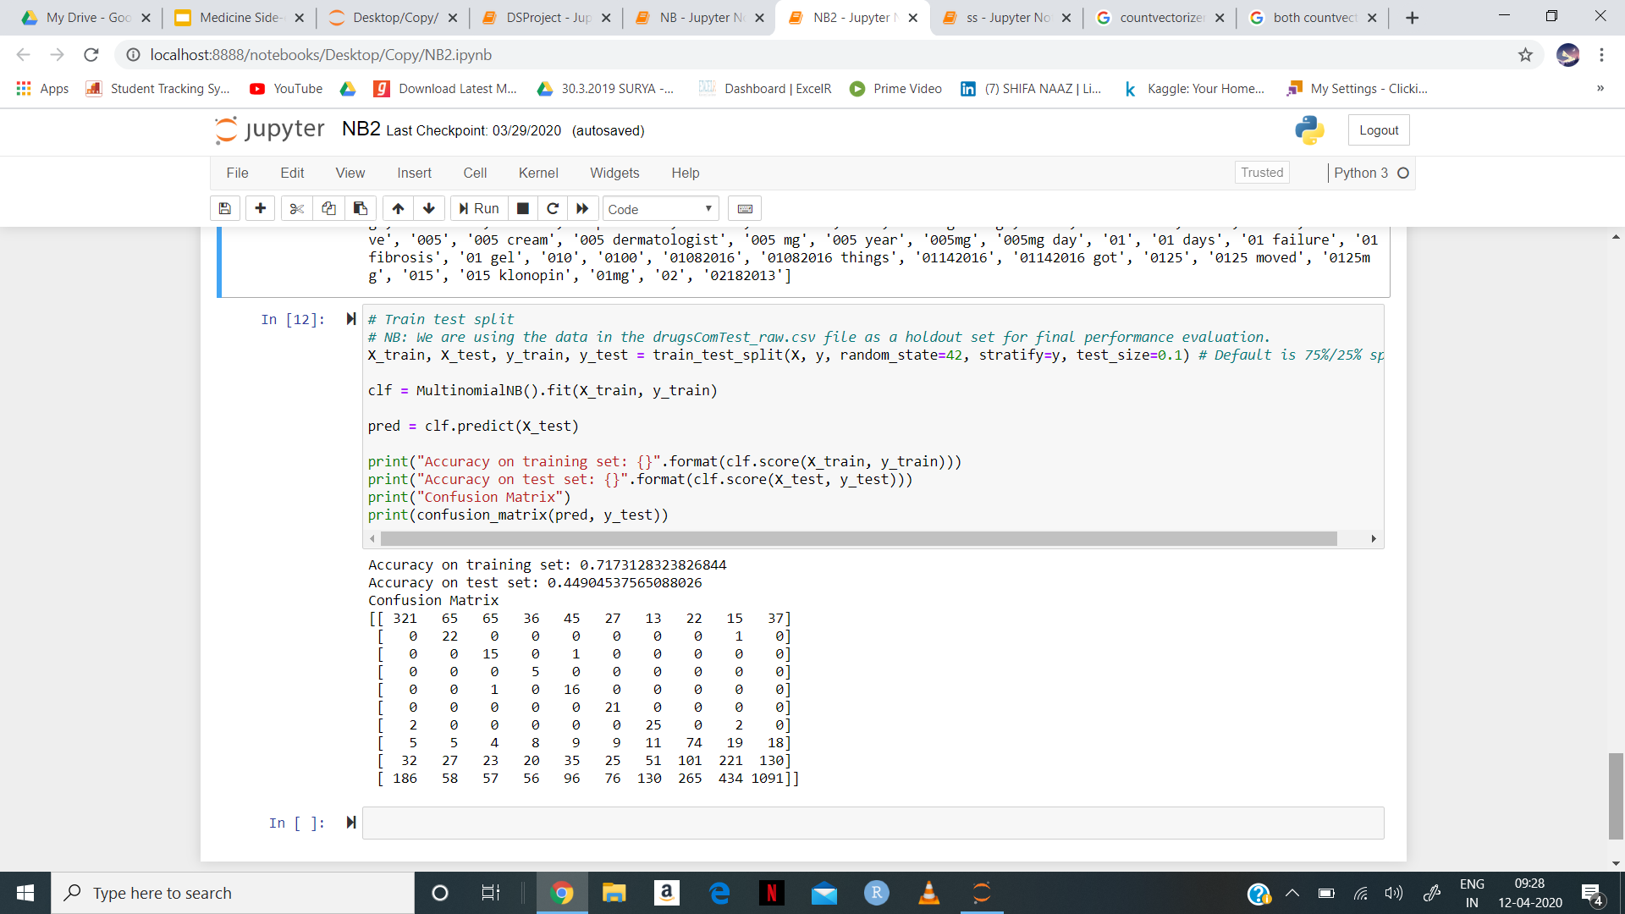
Naive Bayes for 10 class

Slide 23
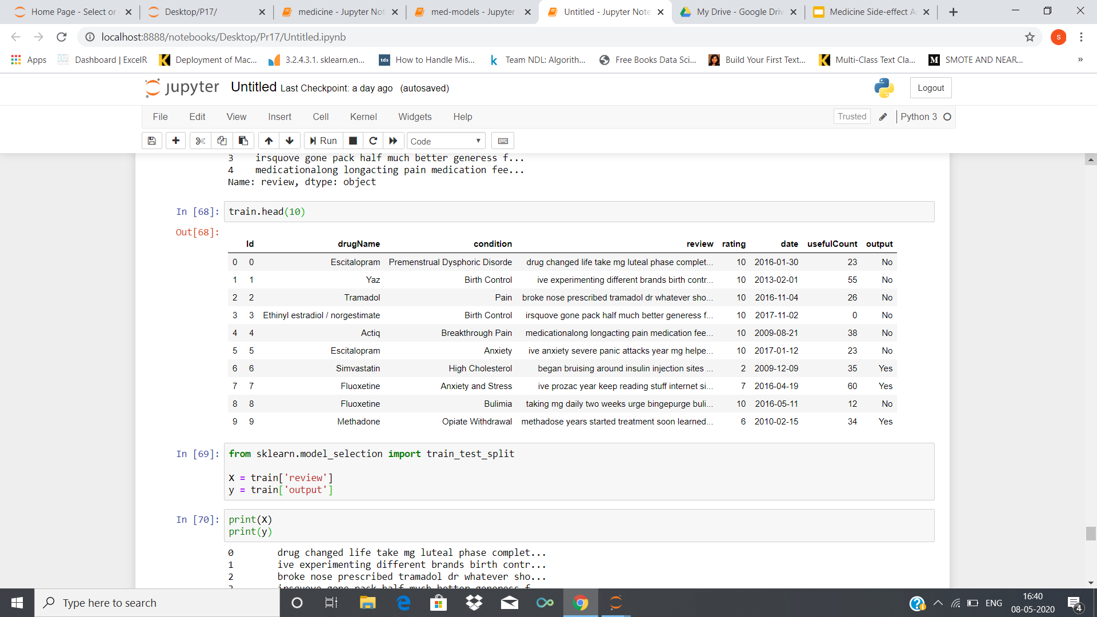
Logistic Regression
Logistic regression is a statistical model that in its basic form uses a logistic function to model a binary dependent variable, although many more complex extensions exist. In regression analysis, logistic regression (or logit regression) is estimating the parameters of a logistic model (a form of binary regression).The logistic model is used to model the probability of a certain class or event existing such as pass/fail, win/lose, alive/dead etc.

Slide 24
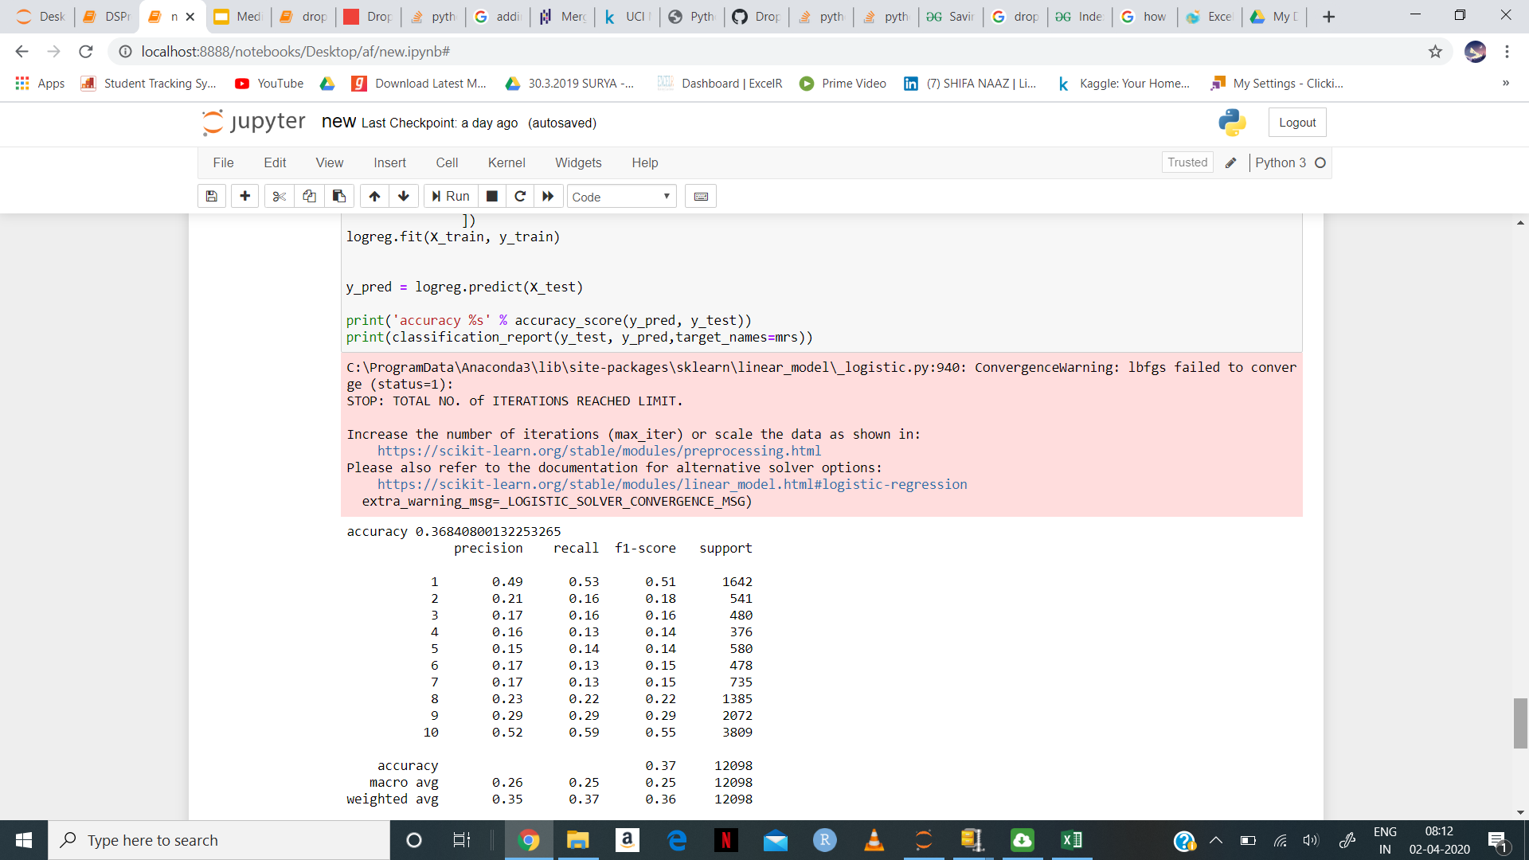
10 Class Logistic regression

Slide 25
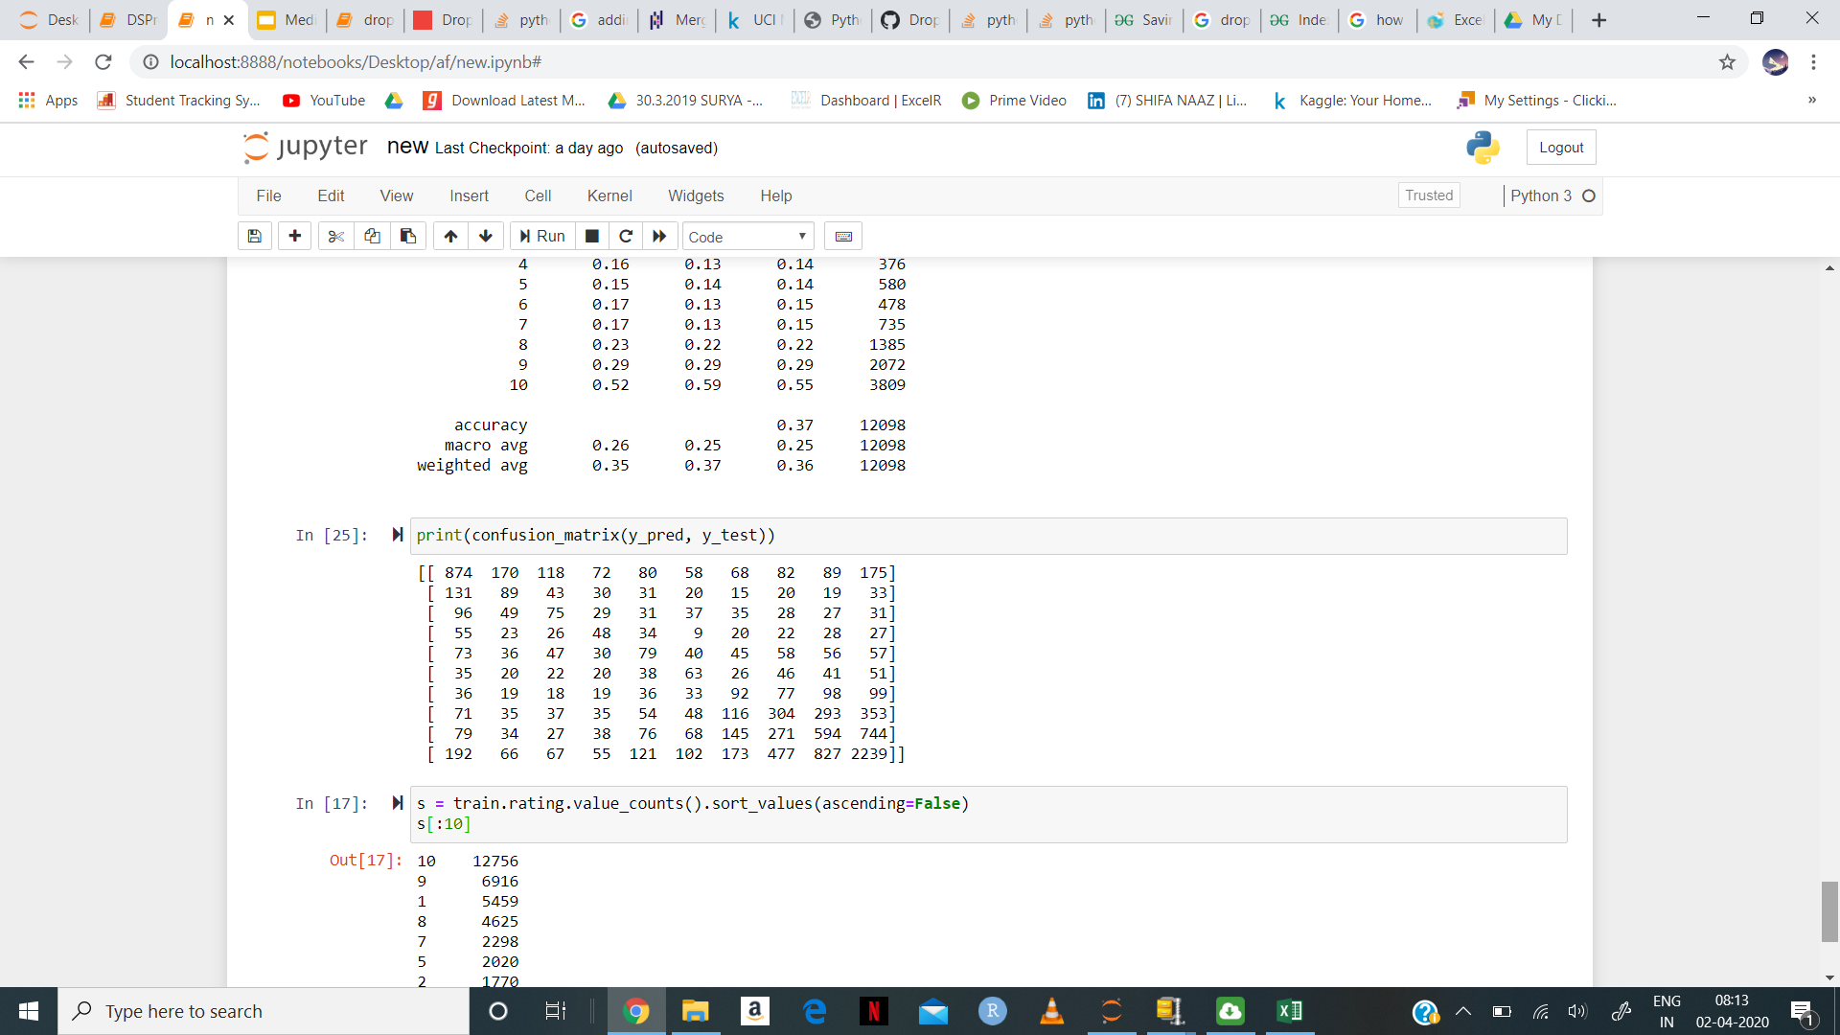
Confusion matrix

Slide 26
Over Sampling
Oversampling simply replicates randomly the minority class examples. Random oversampling is known to increase the likelihood of occurring overfitting. On the other hand, the major drawback of Random undersampling is that this method can discard useful data.
SMOTE stands for Synthetic Minority Oversampling Technique. This is a statistical technique for increasing the number of cases in your dataset in a balanced way. The module works by generating new instances from existing minority cases that you supply as input.

Slide 27
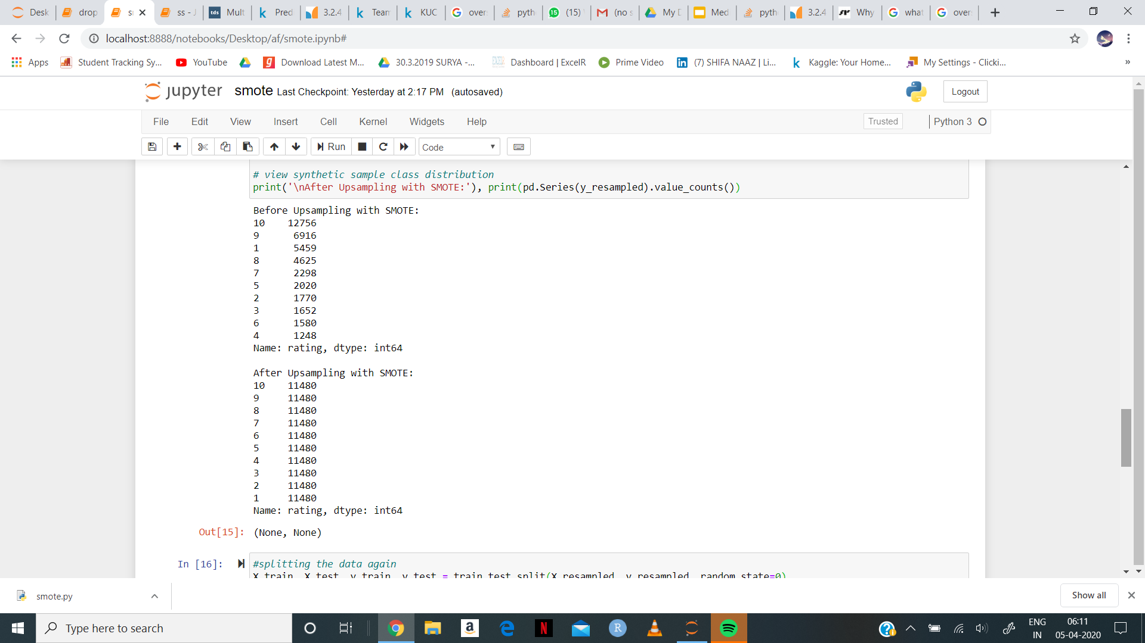
Synthetic sample class distribution

Slide 28
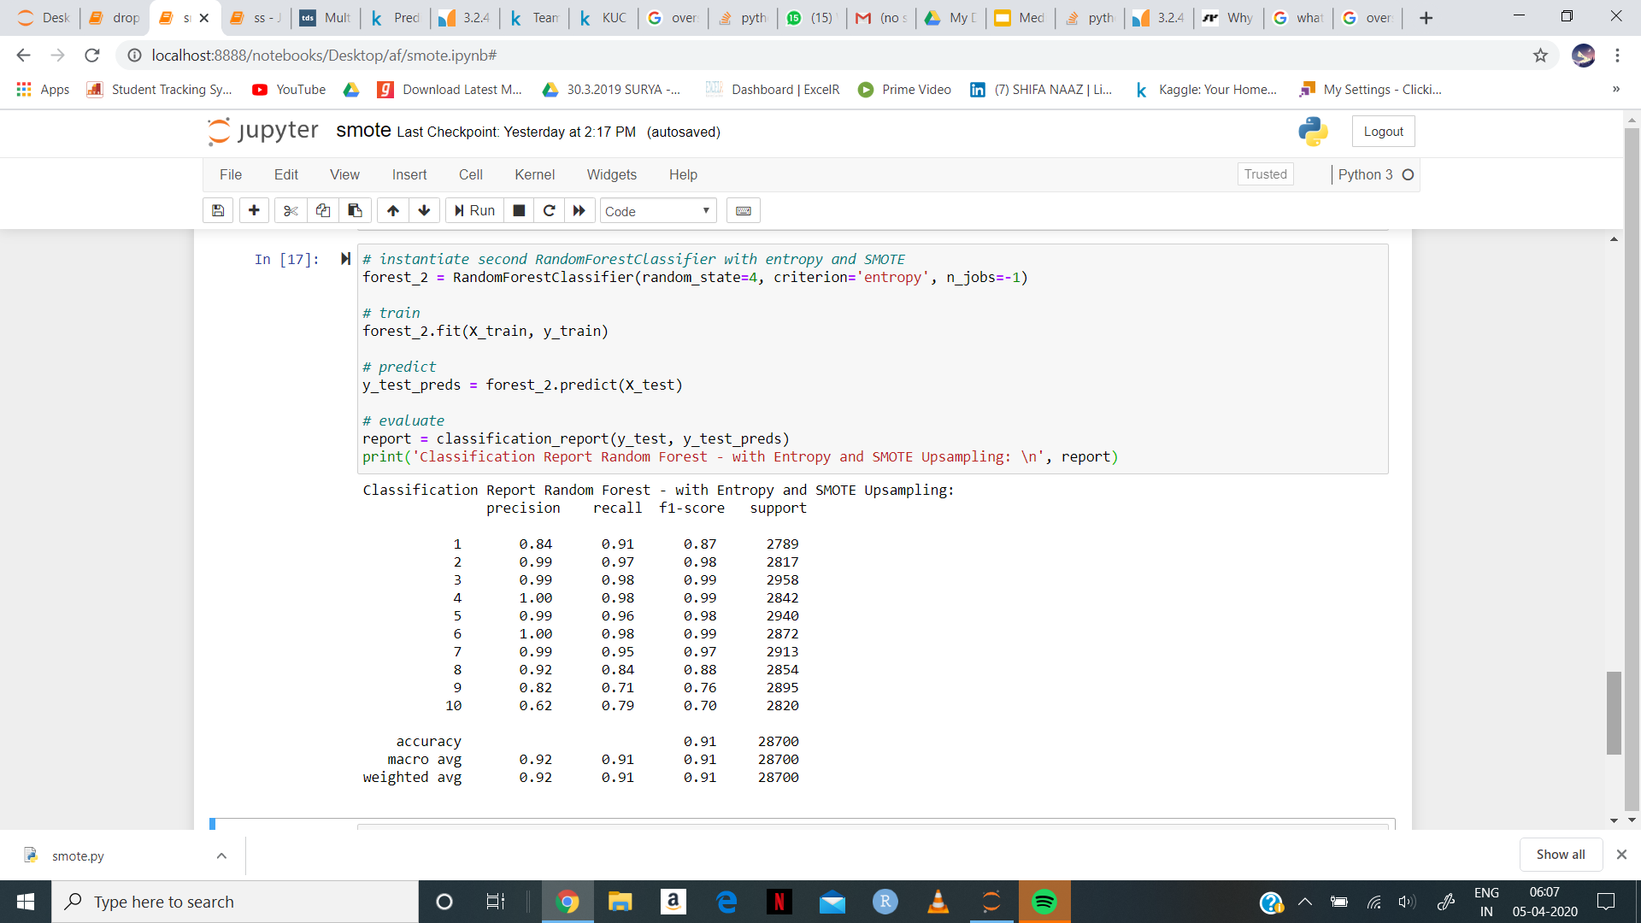
Results using Random forest classifier with synthetic data

Slide 29
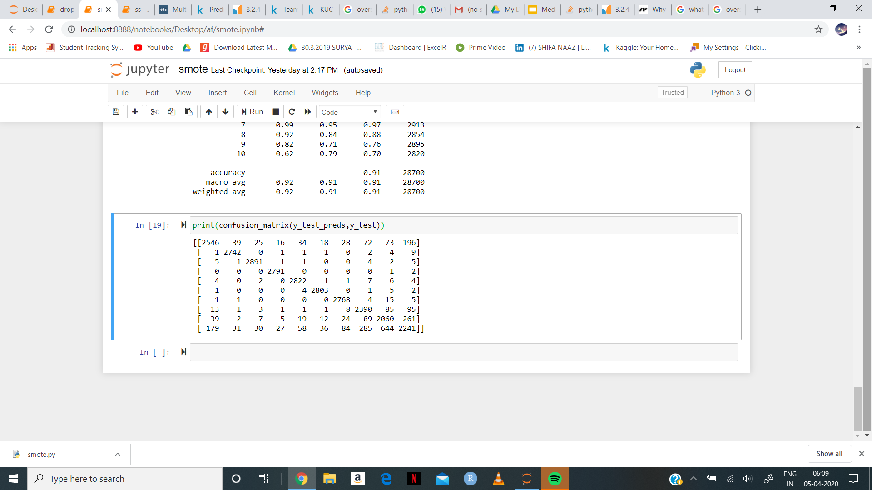
Confusion Matrix

Slide 30
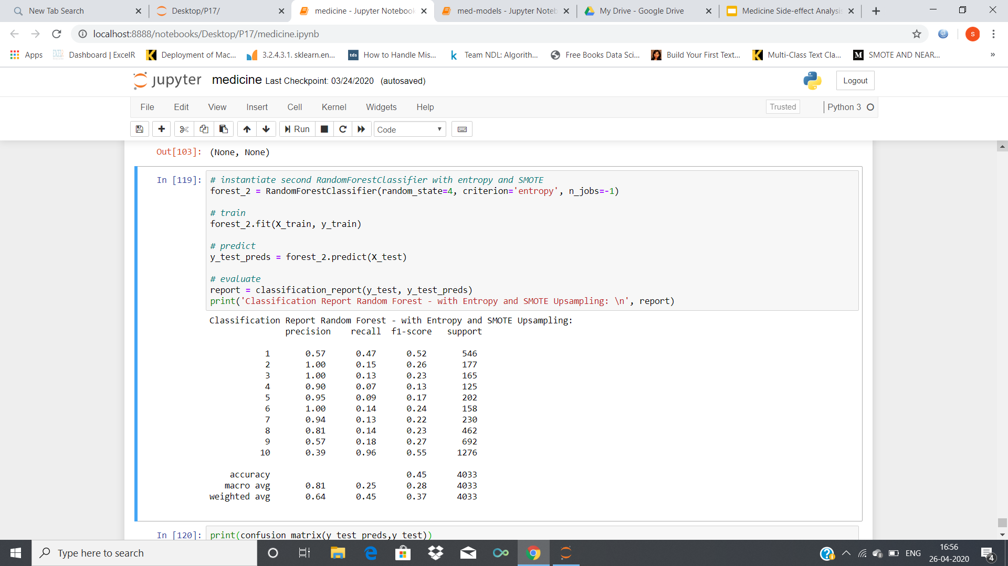
Results using Random forest classifier without synthetic data

Slide 31
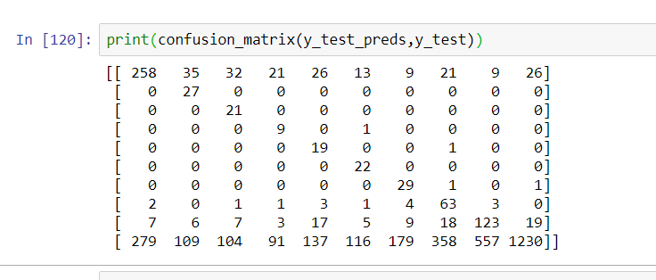
Confusion matrix

Slide 32
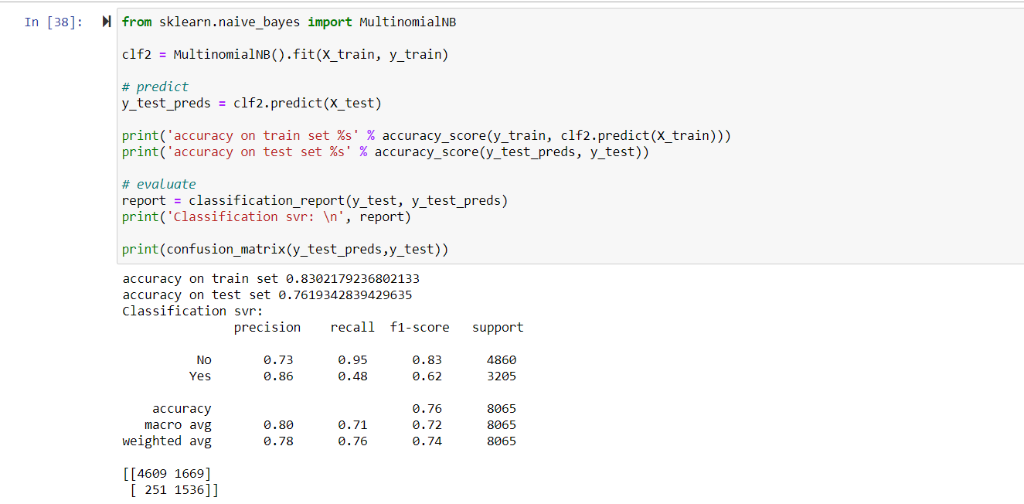
Naive Bayes

Slide 33
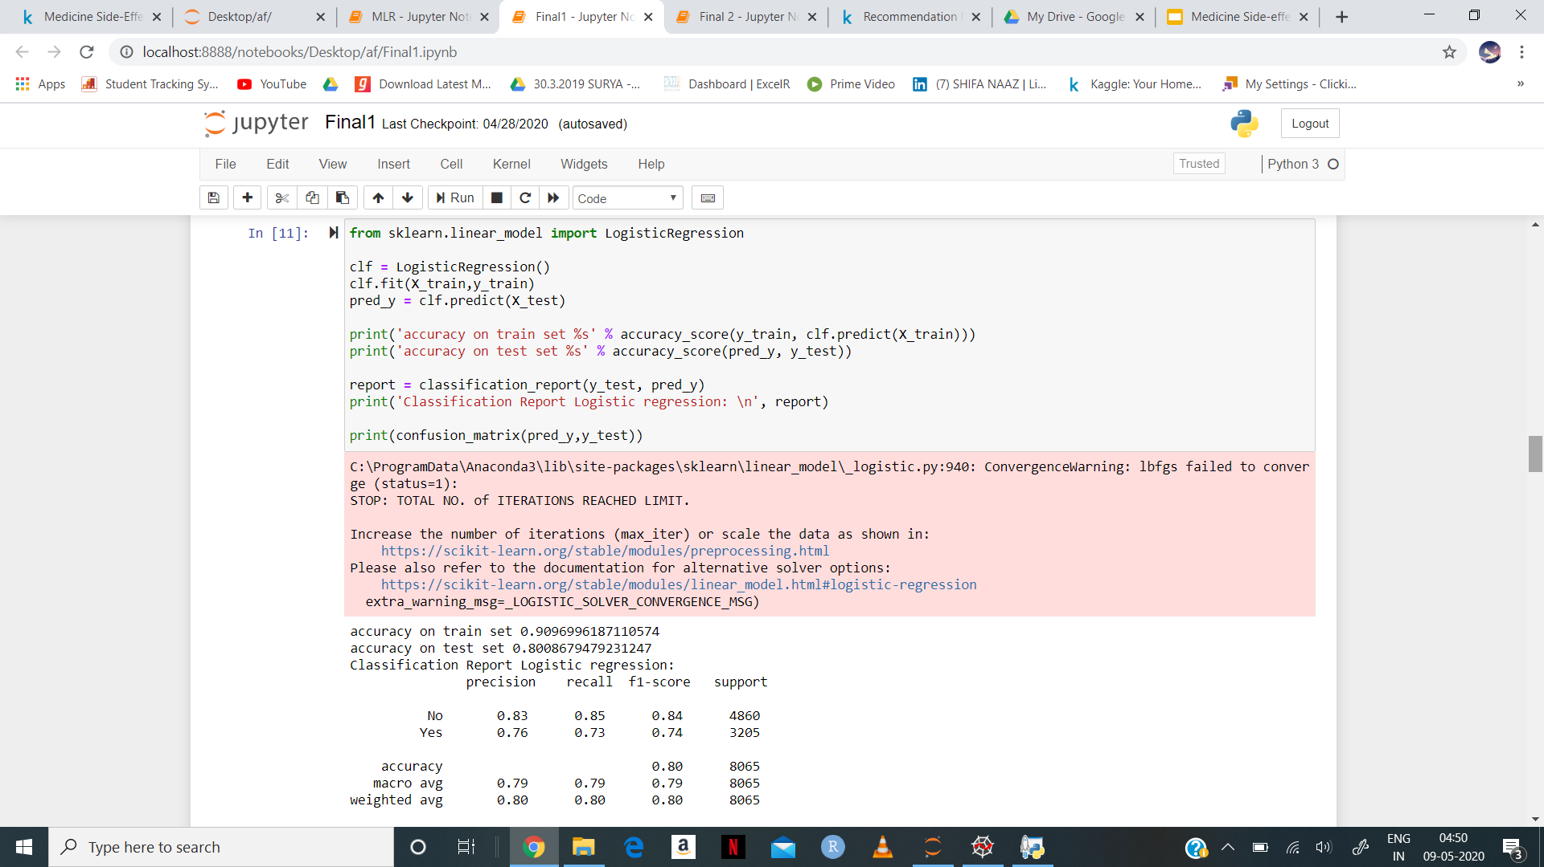
Logistic Regression

Slide 34
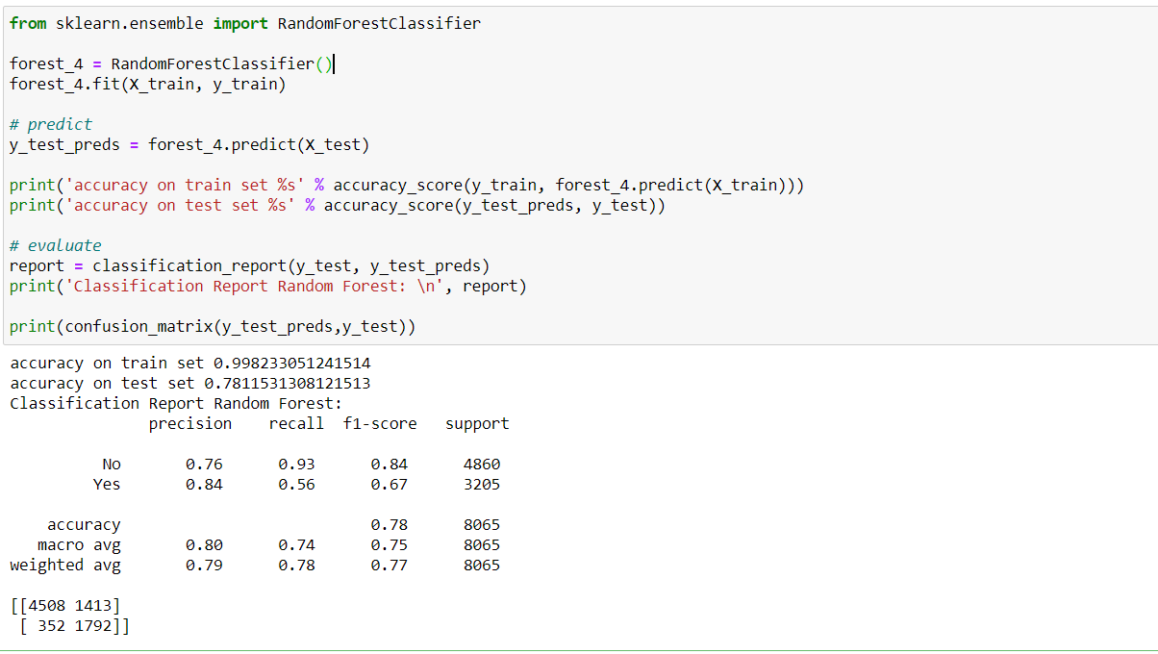
Random Forest

Slide 35
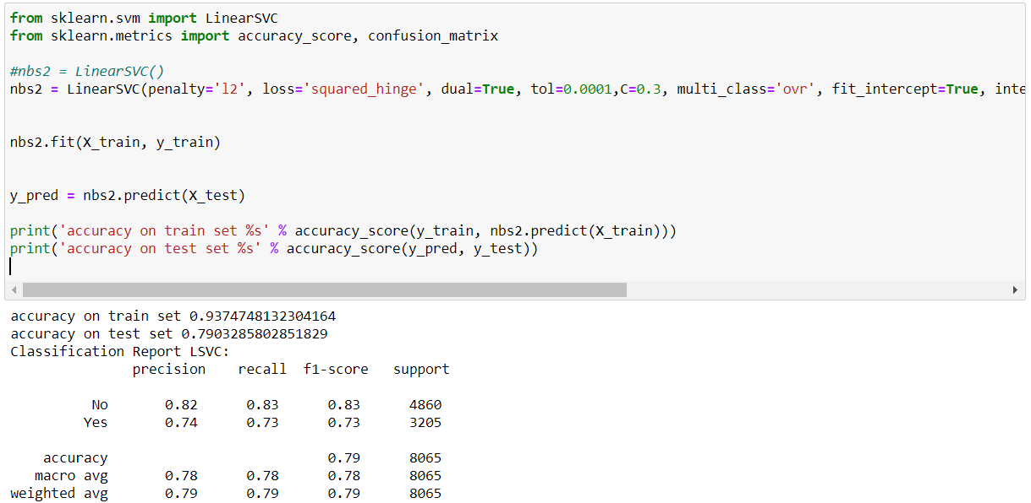
Linear SVC

Slide 36
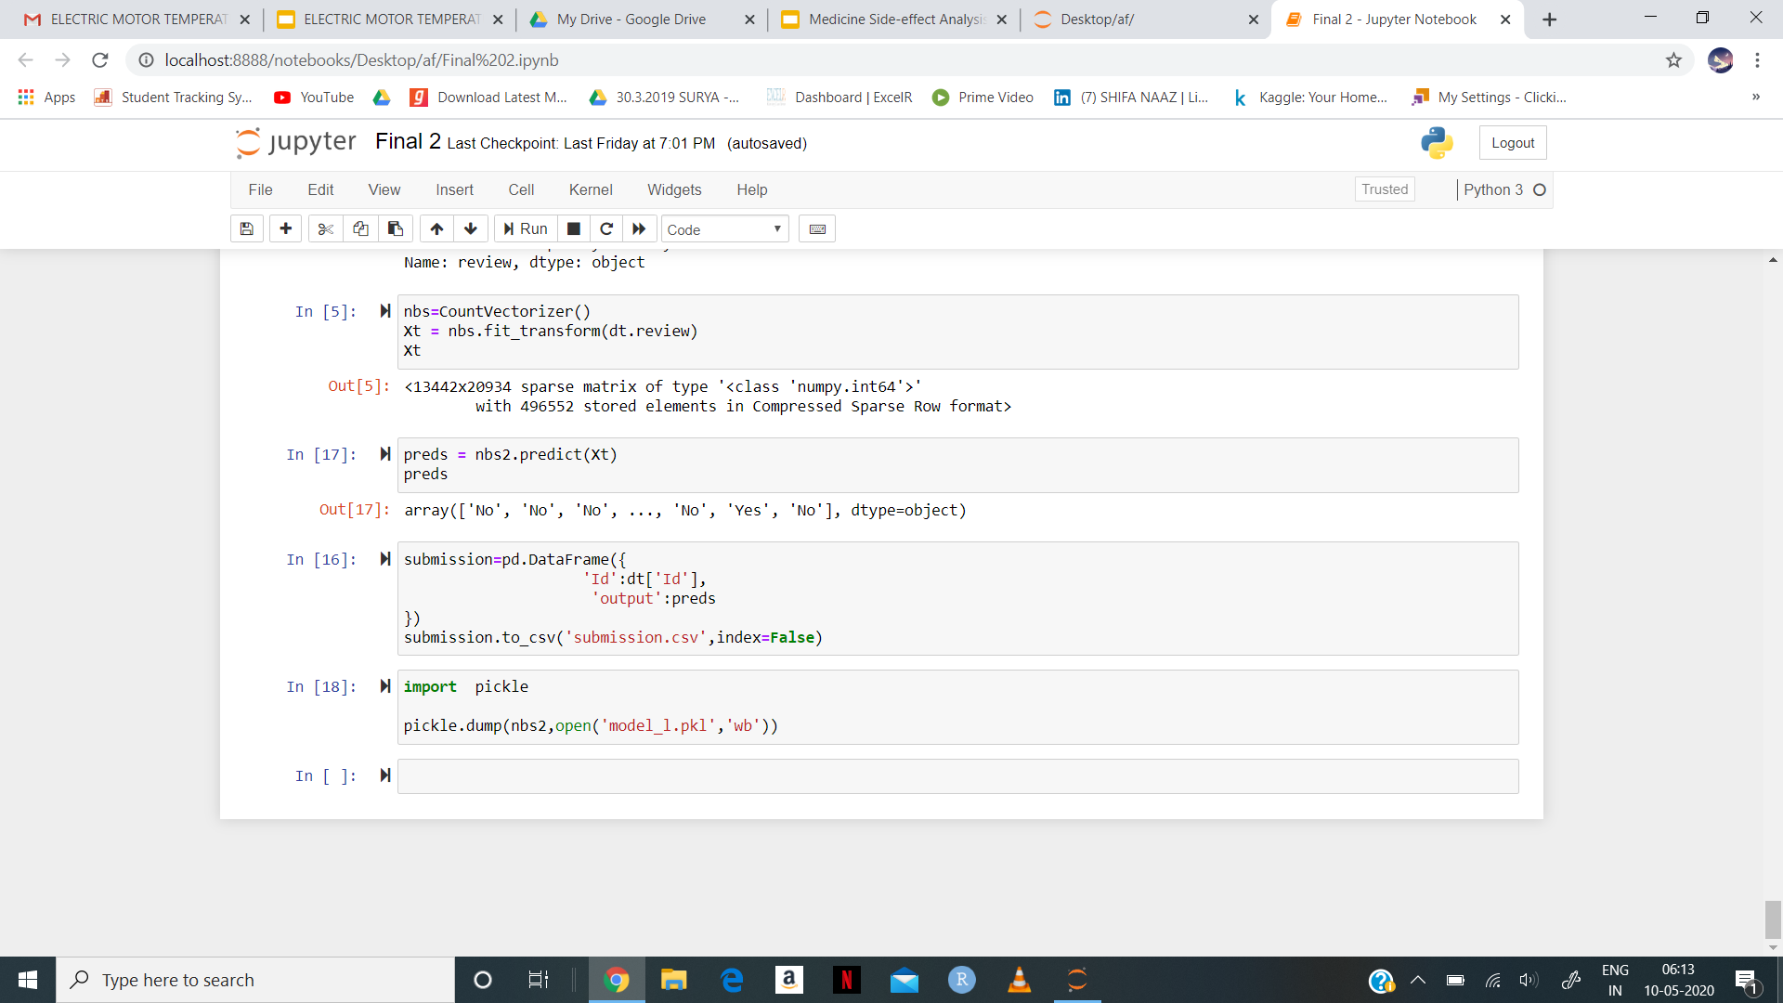
Model Deployment
The Model Deployed is Linear SVC.
For deployment we have create two files like app.py and server.py
Model.pkl file is also created.

Slide 37
Deployment using flask
Flask File creation:
Second file named server.py in this we have import flask
Using @app.route(‘/’) url to execute homepage function which named as DOCTYPE.html
Using @app.route(‘/predict’, mothods=[‘post’]) transfer data to server and provide input
After that we have Predict using this link http://127.0.0.1:5000/

Slide 38
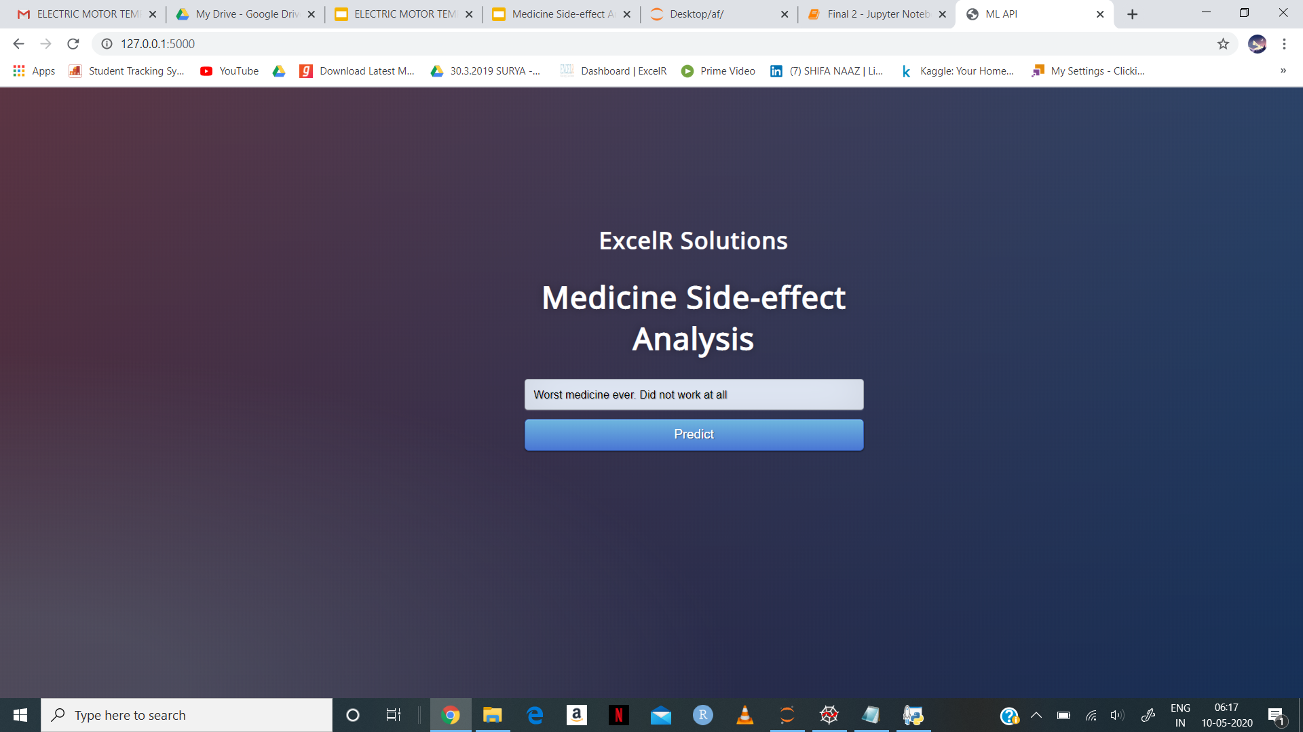
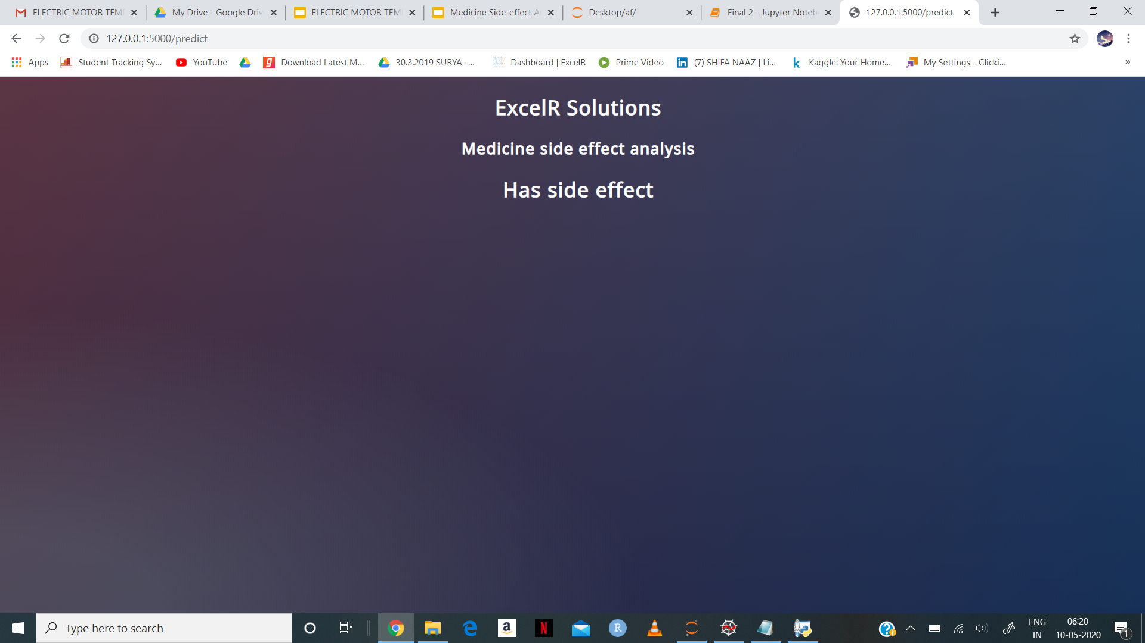
Results:
Input Output

Slide 39
THANK YOU

